Slide 1

HR
ANALYTICS
• Excel • Tableau • Power BI • SQL

Slide 2











Project Summary
Build a scalable HR analytics solution for HR business ecosystem.
Validate data accuracy through end-to-end QA between database and dashboards.
Implement 10+ KPIs Employee Count, Attrition rate, Avg Hourly Rate, Performance Rating etc.
Enable data-driven decisions for different reason for attritions.
Integrate Excel → SQL → Tableau → Power BI in a unified, end-to-end data pipeline.
01
05
02
04
03

Slide 3













Project KPI’s
Department wise
attrition rate
Average attrition rate
01
04
Research & Development experiences the highest employee turnover. Since R&D employees are usually critical resources, this could significantly impact innovation and project delivery.
Employees generally stay around 10–11 years, indicating good tenure among retained employees. However, despite long average tenure, attrition remains high.
Gender Marital Status wise Attrition rate
Last promotion wise attrition rate
02
05
Married, single, and divorced employees exhibit similar turnover patterns. Also, HR strategies may therefore need to focus more on job-related factors rather than demographic characteristics.
Promotion timing appears to have a limited impact on attrition, as turnover rates remain nearly identical across promotion groups.
Monthly Income wise attrition rate
Job Role vs Work Life Balance
03
06
Attrition is almost identical across all salary groups. Compensation alone may not be the primary reason employees leave.
Work-life balance appears relatively consistent across job roles. Also, Sales Executives show the lowest score (~2.47), which may indicate higher work pressure.

Slide 4
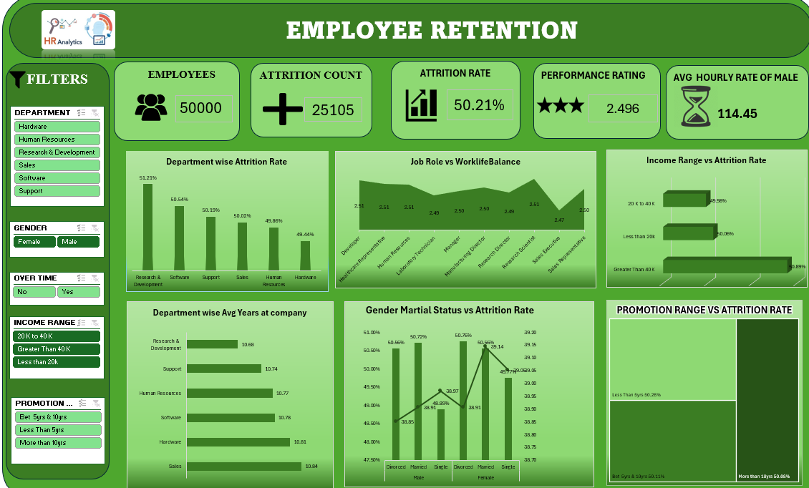
Excel Dashboard

Slide 5









Excel Dashboard - Initial Findings & Data Trend
Covers 50,000 employees, with 25,105 attritions — an overall attrition rate of 50.21%, which is unusually high.
Critical Attrition
Work-Life Balance
Research & Development has the highest attrition rate at 51.21%, indicating the greatest employee turnover.
Work-life balance scores remain consistent across job roles, ranging from 2.47 to 2.51.
Lowest Attrition
Employee Tenure
Hardware department records the lowest attrition rate at 49.44%, reflecting comparatively better employee retention.
Sales department employees have the highest average tenure (10.84 years), while Research & Development employees have the lowest (10.68 years).
Income Analysis
Business Recommendation
Employees earning more than 40K have the highest attrition rate (50.89%), showing that higher salaries do not guarantee retention.
Improving employee engagement, career development, and work-life balance—especially in Research & Development—can help reduce attrition and improve retention.

Slide 6
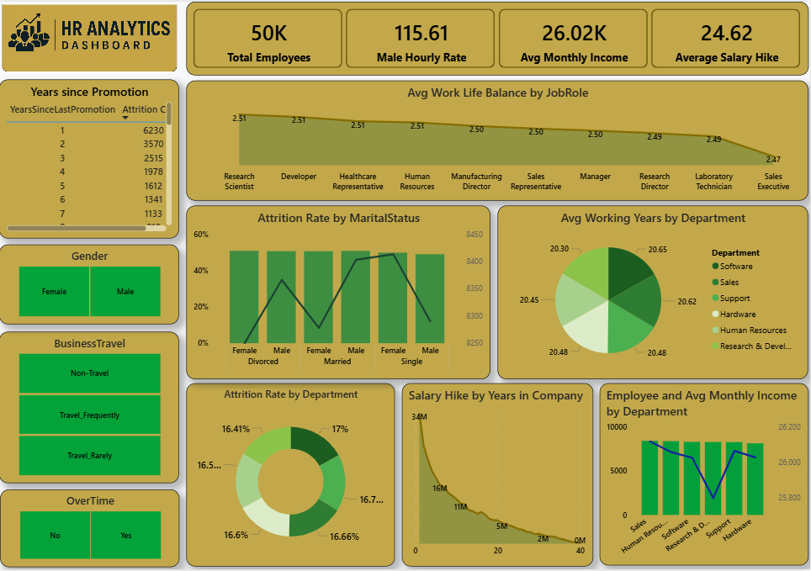
Power BI Dashboard

Slide 7




Power BI Dashboard - Initial Findings & Data Trend
01
Promotion Delay Impacts Attrition
Employees promoted within 1 year show the highest attrition count (6,230 employees).
02
Work-Life Balance Varies by Job Role
Highest work-life balance score: Research Scientist (2.51)
Lowest work-life balance score: Sales Executive (2.47)
03
Marital Status Analysis
Single employees exhibit slightly higher attrition rates, while married employees demonstrate better retention.
04
Average Working Years
Employees stay approximately 20–21 years across departments. Support Department has the highest average tenure (20.65 years), while Software has the lowest (20.30 years).

Slide 8
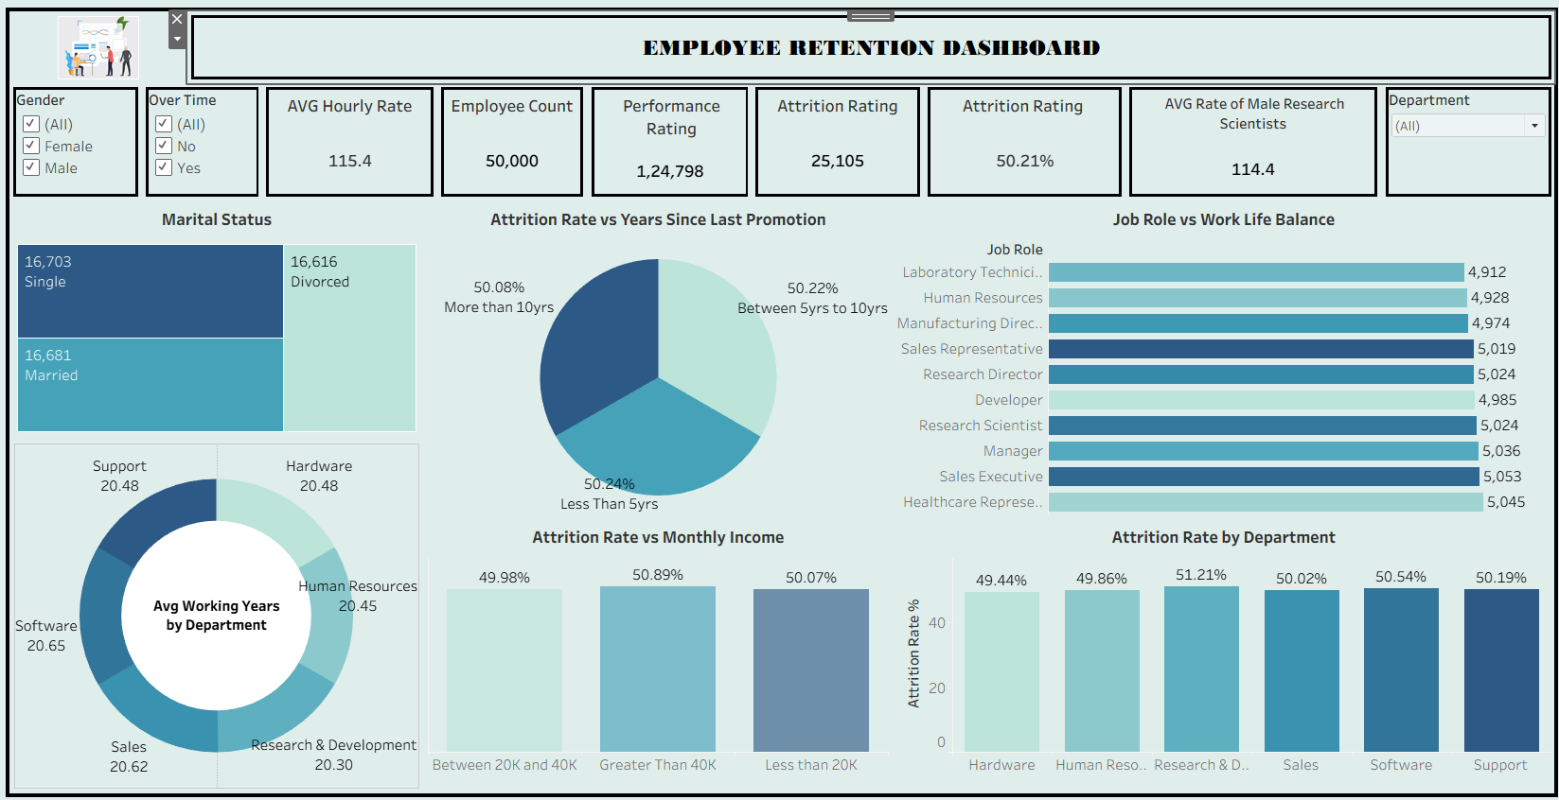
Tableau Dashboard

Slide 9







Tableau Dashboard - Initial Findings & Data Trend
Work-Life Balance
Healthcare Reps lead WLB score at 2.52. Manufacturing Directors lag at 2.46. Scores are tightly clustered (2.46–2.52).
Income vs Retention
Marital Status Split
Mid-income (20K–40K) employees have the lowest attrition (49.98%), while high earners (>40K) exit most (50.89%).
Workforce is nearly evenly split: Single 16,703 · Married 16,681 · Divorced 16,616. No dominant group.
Critical Attrition
Workforce Overview
50.21% attrition rate — over half the workforce has left. Research & Development has the highest rate at 51.21%.
The organization has 50,000 employees, with 25,105 employees leaving, resulting in an overall attrition rate of 50.21%.

Slide 10
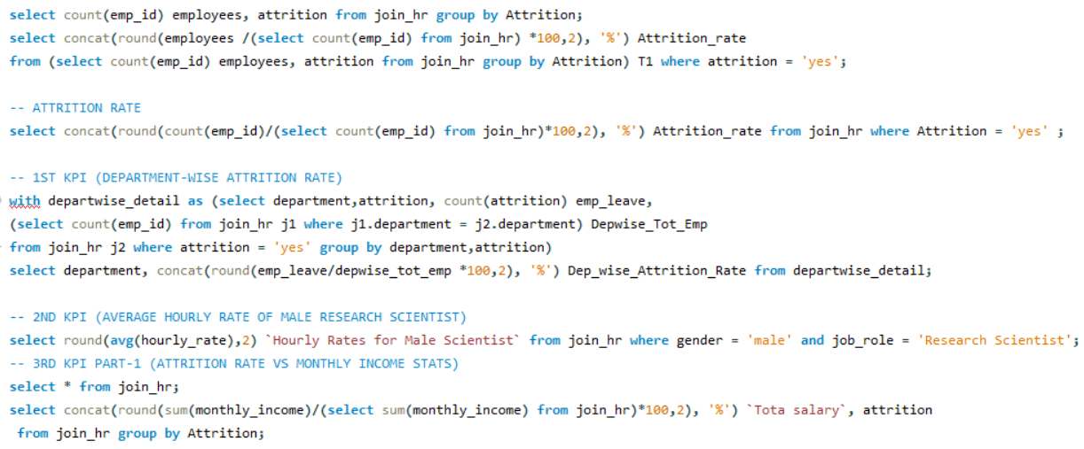
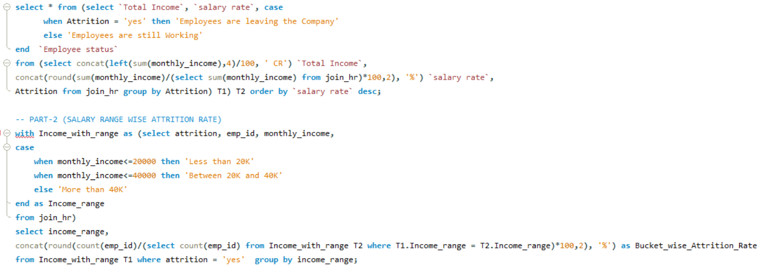
SQL Queries

Slide 11

SQL - Initial Findings & Data Trend
Single Male Vs Female Attrition Rate
01
For Single Males Who Are Doing Overtime Salary Between 21k To 30k And Who Didn't Got Promoted Between 2 To 4 Yrs Their Attrition Rates Are Around 64% In Software Department(23% In Sales Department) And 37.84% Who Are Not Doing Over-time In Software Department.
For Single Females Who Are Doing Over Time Salary Is In Between 21k To 30k And Didn't Got Promoted In Between 2 To 4 Yrs Their Attrition Rate Is Around 68%
05
Married Male Vs Female Attrition Rate
Married Male Who Are Doing Over-time And Didn't Got Promoted In Less Than 2yrs And Whose Salary Is Greater Than 40k Their Attrition Rate Is More Than 75% In R&D Department Reason Is They Are Doing Over-time Because Attrition Rate Is Around 46% For The Same Who Are Not Doing Over-time(Huge Difference Of Around 30% ).
Married Female Who Are Doing Over-time Their Attrition Rate Is Very High 54.40% In R&d Department And Who Didn't Got Promoted In Between 4 To 8 Years And Salaries Is Less Than 10k Their Attrition Rate Is More Than 68%
02
06
Divorced Male Vs Female Attrition Rate
07
Divorced Male Who Are Doing Over-time And Who Didn't Got Promoted In Between 4 To 8 Yrs For Salary Less Than 10k In R&d Department Their Attrition Rate Is 78% And Who Are Not Doing Overtime
Their Attrition Rate Is 48% (It’s a Huge Difference Of 30%) But For Same Males In Hardware Department Their Attrition Rate Is 20%
Divorced Females Who Are Not Doing Over-time Salary Between 11k To 20k And Didn't Got Promoted In Less Than 2yrs Their Attrition Rate Is 77% In R&D Department .
03
08
Over-time Attrition Rate
04
For Married Males In R&D Department Salary>40k And Didn't Got Promoted In Less Than 2yrs Their Attrition Difference Over-time Vs Non Over-time Is 30%
For Divorced Males In R&D Department Salary<10k And Didn't Got Promoted Between 4 To 8yrs Their Attrition Difference Over-time Vs Non Over-time Is 30%

Slide 12





Key Takeaways - Business Insights
Critical Attrition Risk
Compensation Isn't the Driver
R&D has the highest attrition (51.21%), the steepest of any department — a concern since R&D staff are usually hard to replace
Attrition is nearly flat across income bands (49.98%–50.89%); higher pay doesn't reduce exits, even for >40K earners
Tenure ≠ Retention
Average tenure is healthy (10–11 yrs), but high overall attrition (50.21%) persists despite this — long-tenured employees still leave
Work-Life Balance Is Uniform but Weak
WLB scores cluster tightly (2.46–2.52) across roles; Sales Executives and Manufacturing Directors score lowest, hinting at workload pressure

Slide 13






Future Recommendations
Traditional
Modern
R&D attrition untracked beyond rate (51.21%)
Conduct exit interviews specifically in R&D to identify root causes (workload, career growth, management)
Attrition analysed only against demographics/pay
Build a predictive attrition model using job-role, engagement, and performance data instead
Launch targeted WLB initiatives for lowest-scoring roles (Sales Executives, Manufacturing Directors)
Work-life balance measured but not acted on
Static dashboards (Excel/Tableau/Power BI) report past attrition
Move to a live monitoring dashboard with attrition alerts by department, flagging spikes early

Slide 14
Thank You

